Slide 1
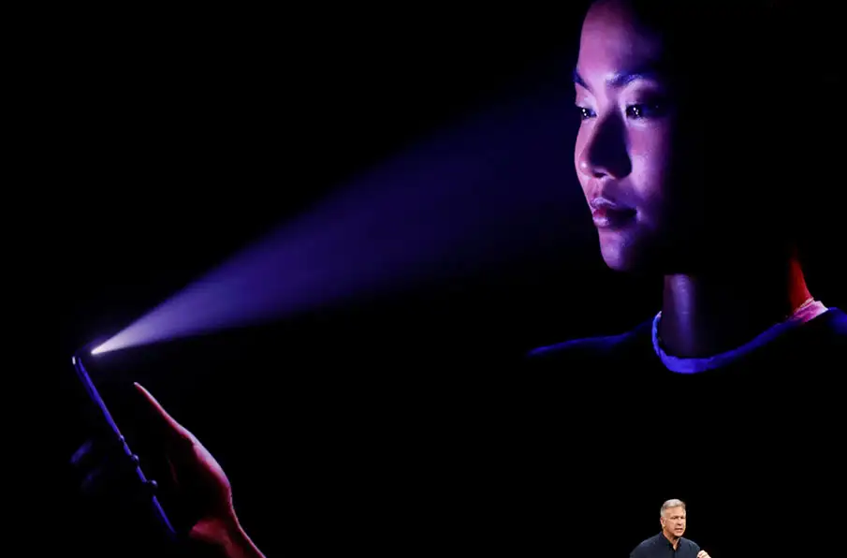
Introduction Facial Recognition In Authentication
By Nalongsone Danddank.
Instructor: Jennifer Grant.
Computer Security ICS-382/CYBR332.
Metropolitan State University.
Notes:
Hi guys, well come to my presentation video, my topic is Introduction facial recognition in authentication.
and my name is Nalongsone Danddank, I am a student from Metropolitan State University, And today I would like to present the Video that is a part of Computer Security course ICS 382 by Professor Jennifer Grant.
By the way, this video is solely for the educational purpose and I am not liable for any problems that could be caused by this video.

Slide 2
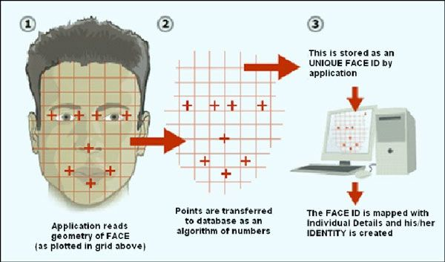
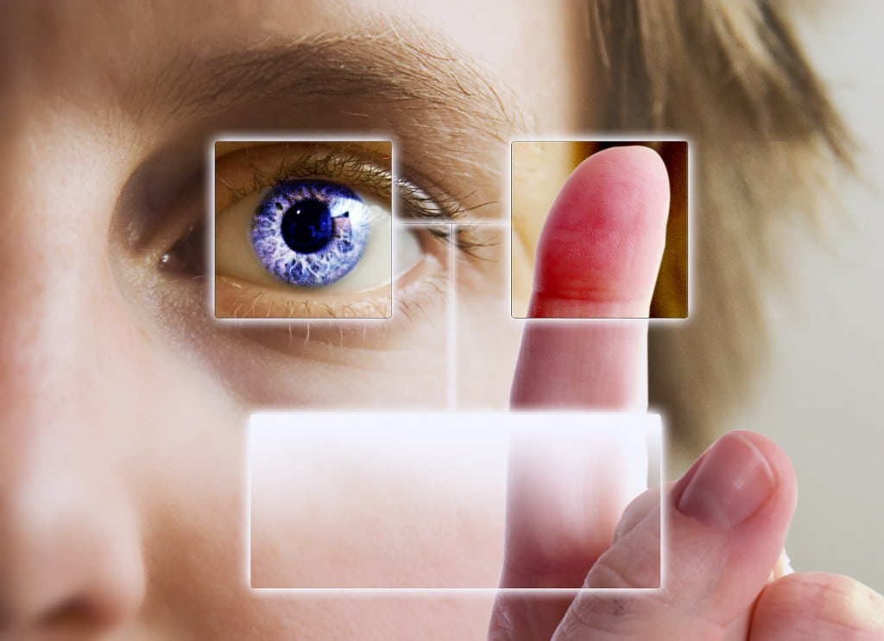
What is Facial Recognition ?
a way of identifying or confirming an individual's identity using their face.
a category of biometric security
mostly used for security and law enforcement
Notes:
So, first thing, we have to understand what is Facial Recognition.
the Facial recognition is a way of confirming a person's identity by their face. And the system can be used to identify people in photos, videos, and in real time camera.
Facial recognition is a category of biometric security. and we also have the Other forms of biometric software like voice recognition, fingerprint recognition, and eye retina.

Slide 3
How does facial recognition work in Authentication
Step 1: Face detection
Step 2: Face analysis
Step 3: Converting the image to data
Step 4: Finding a match
Notes:
The next question is how does facial recognition work in authentication.
Generally, the systems should process as 4 step:
Step 1: Face detection : The camera detects or locates the image of a face.
Step 2: Face analysis: Mostly it relies on 2D image rather than 3D images because it convenient to match a 2D image with public photos or in a database.
Step 3: Converting the image to data: this processing is based on the person's facial features.
Step 4: Finding a match: that compared against a database of faces.

Slide 4
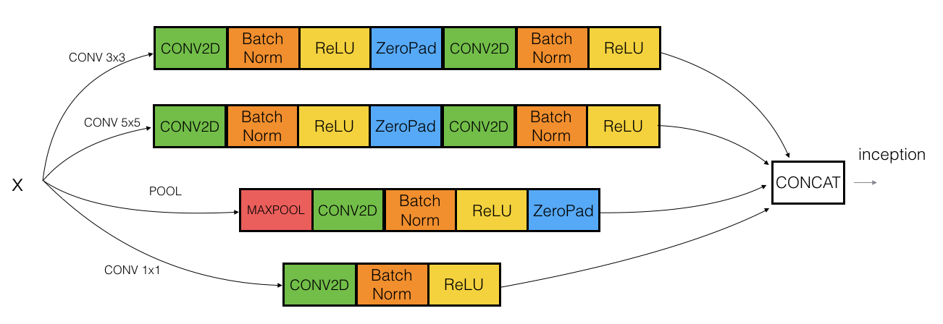
Experiment Code of Facial Recognition
Notes:
Ok, next, I would like to show an experiment, how to training and run a python code of deep learning algorithm.
but before we go there, I think we should see the diagram of deep learning or neural network algorithm. we can see that there are a lot of library or frameworks that we will use to run. and these library or fameworks all is open soures on internet.

Slide 5
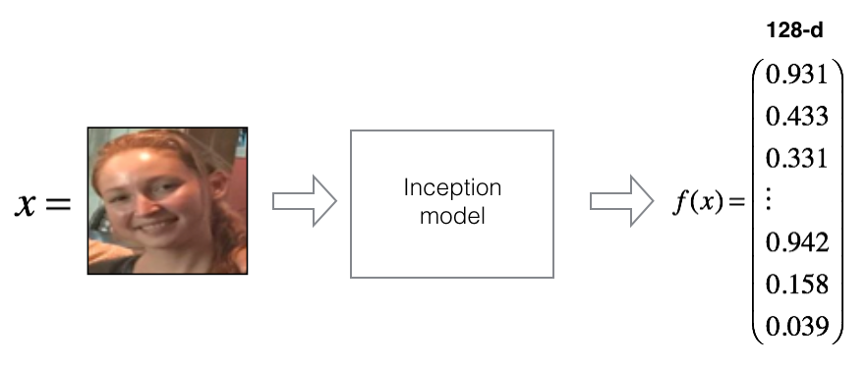

Slide 6
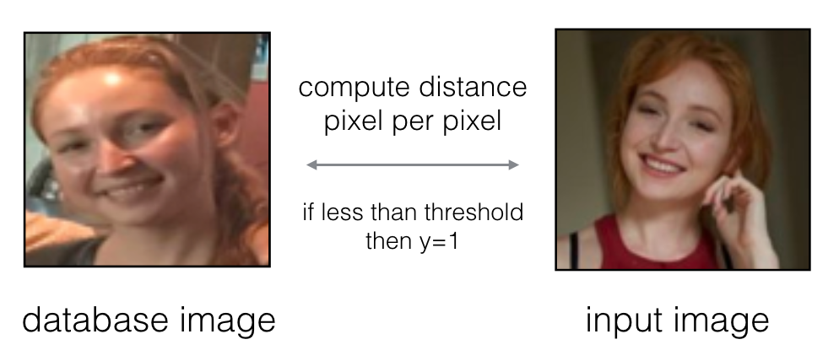
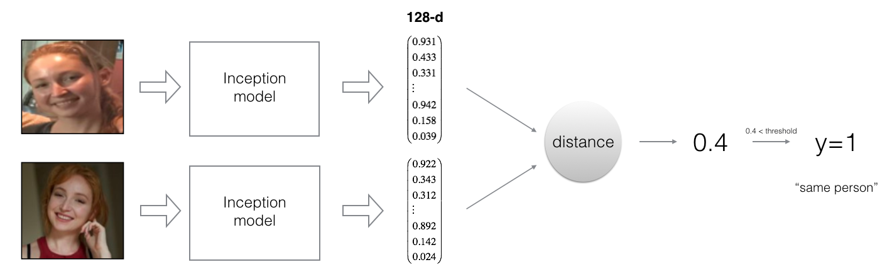

Slide 7
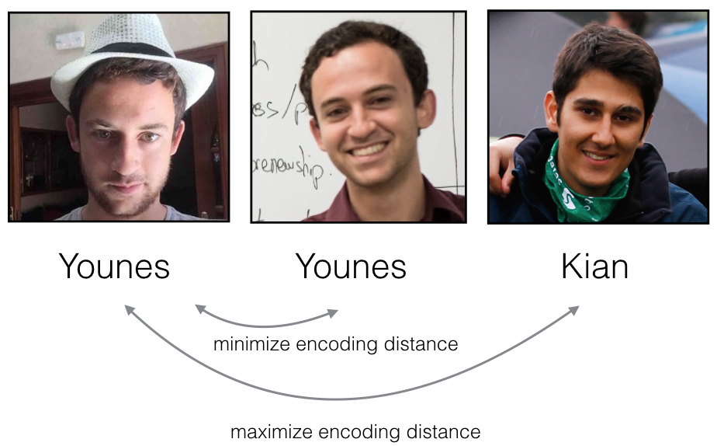

Slide 8
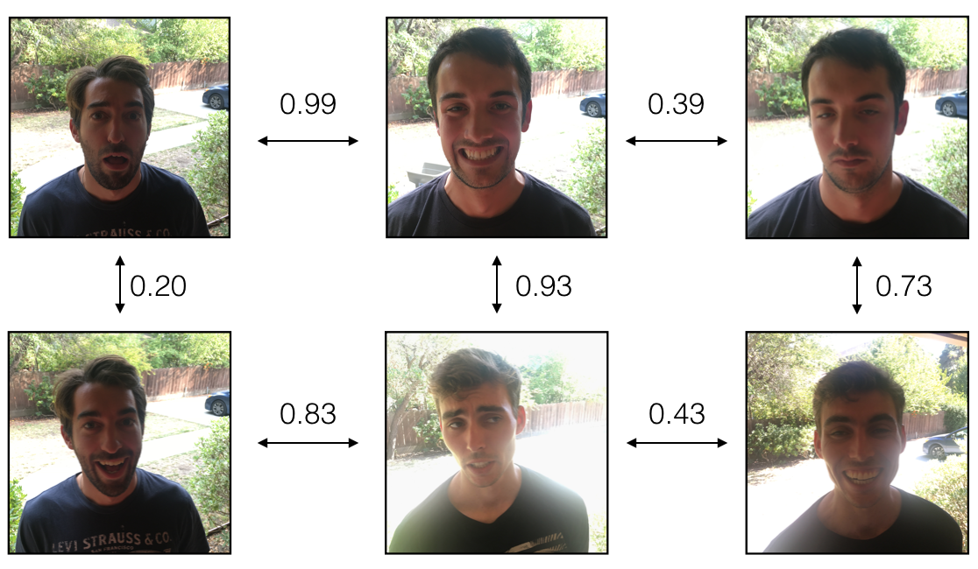

Slide 9
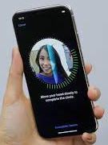
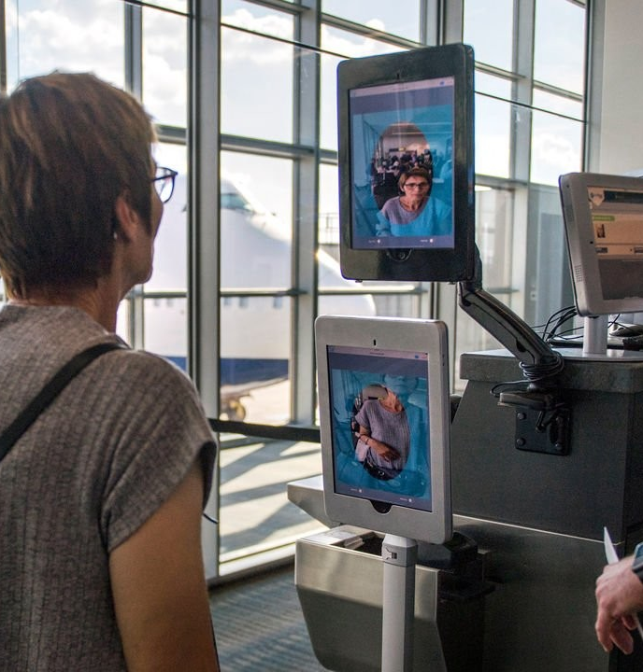
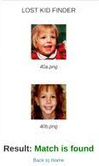
Examples of Facial Recognition In Authentication
Notes:
Well, I hope you guys could make sense on the code.
for the next, we go to see the examples of facial recognition in our real world.
like the first example, is using face recognition to unlock our phones or device. like iPhone Face ID.
the second is the airports and border control use this technology to provide more convinaint for travellers and allow them use ePassport by thier face.
the last example is finding missing persons by public camera on around city to find out the missing person.

Slide 10
Pros & Cons
Pros:
Greater convenience
Faster processing
Increased security
Reduced crime
Removing bias from stop and search
Cons:
Surveillance
Scope for error
Breach of privacy
Massive data storage
Notes:
So, their have advantages and disadvantage:
the advantages is convenience, quick, automatic, increased security, reduced crime, removing bias from stop and search ...
and there Also take a disadvantages like some people don’t like to be filmed in public. and some time machine would occur the error. another things is Breach of privacy and it requires large data that need to be storage.

Slide 11
References:
Florian Schroff, Dmitry Kalenichenko, James Philbin (2015). [FaceNet: A Unified Embedding for Face Recognition and Clustering](https://arxiv.org/pdf/1503.03832.pdf)
Yaniv Taigman, Ming Yang, Marc'Aurelio Ranzato, Lior Wolf (2014). [DeepFace: Closing the gap to human-level performance in face verification](https://research.fb.com/wp-content/uploads/2016/11/deepface-closing-the-gap-to-human-level-performance-in-face-verification.pdf)
The pretrained model we use is inspired by Victor Sy Wang's implementation and was loaded using his code: https://github.com/iwantooxxoox/Keras-OpenFace.
Our implementation also took a lot of inspiration from the official FaceNet github repository: https://github.com/davidsandberg/facenet
https://www.kaspersky.com/resource-center/definitions/what-is-facial-recognition
https://www.javatpoint.com/types-of-biometrics
https://www.coursera.org/specializations/deep-learning
https://www.thalesgroup.com/en/markets/digital-identity-and-security/government/biometrics/facial-recognition
Notes:
if you guy like to go deeper to understand, I would like to recommand go researse more on internet, there are a lot open sources and knowledge to learn.

Slide 12
Thanks

